Slide 1



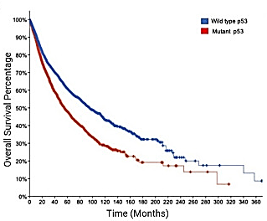
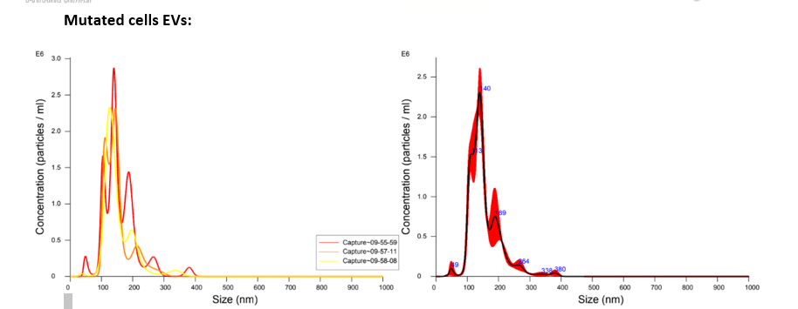
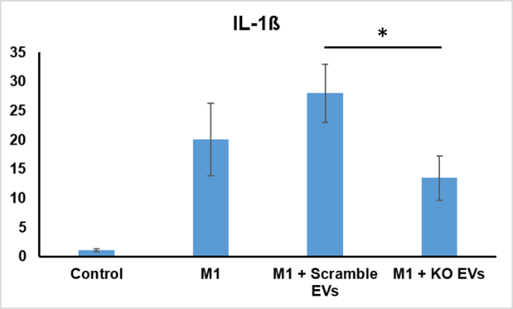
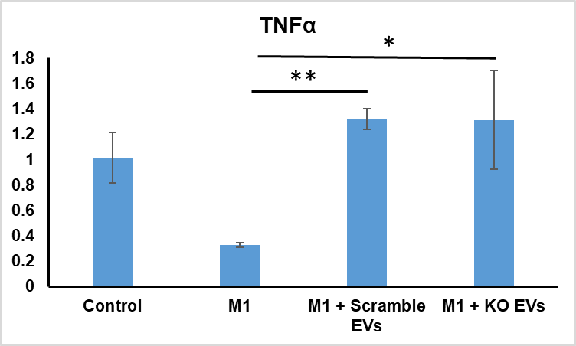
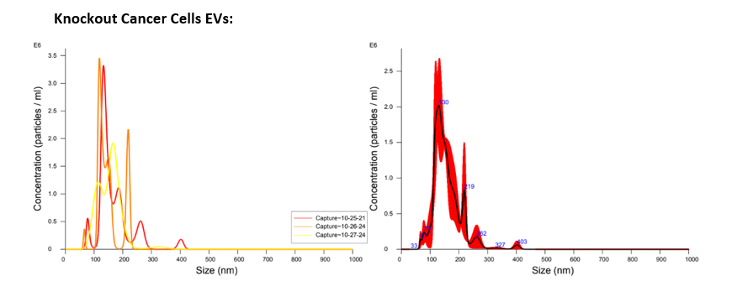
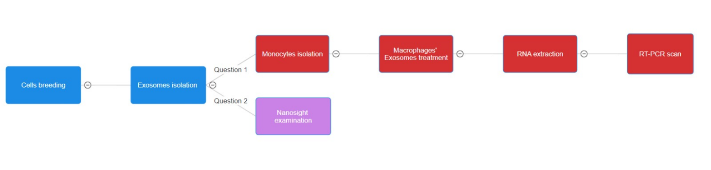
Influence of P53-Mutated Cancer Cells’ Derived Exosomes on M1 Macrophages
Amit Atal ¹, Bibek Bhatta², Tomer Cooks²
1. Jusidman Science Center for Youth, Ben-Gurion University of the Negev, Beer, Sheva Israel & Alpha program, Future Scientists Program, Tel Aviv, Israel.
2. The Shraga Segal Department of Microbiology and Immunology, Faculty of Health Science, Ben Gurion University, Beer Sheva, Israel.
.
Introduction
Cancer, a leading cause of death, results from cells dividing uncontrollably and forming tumors that invade healthy tissue. Exosomes are small vesicles released by cells, play a critical role in cell communication and can influence recipient cell behavior. This research explores the interaction between exosomes from P53-mutated cancer cells and M1 macrophages. The P53 gene, crucial for regulating cell growth, is frequently mutated in cancers, leading to loss of tumor suppression and new, oncogenic functions. This study aims to understand how exosomes from P53-mutated cancer cells affect M1 macrophages. In addition, we aimed to discover what are the physical differences between mutant p53 (mutp53) and knock-out(KO) p53 cancer cells derived exosomes.
Figure 1 Survival rate of human cancer carriers (10,953 patients from 32 different researches), red line symbolizes people with mutant p53 gene, and blue line symbolizes patients with wild type p53 gene.
Results
Our research found that when M1 macrophages were exposed to exosomes derived from cancer cells with a gain of function (GOF) mutation in the P53 gene, they were able to maintain their M1 phenotype. This contrasts with macrophages exposed to exosomes from cancer cells without the P53 gene, which did not sustain the M1 phenotype as effectively. These findings suggest that exosomes from P53-mutated cancer cells have a distinct influence on macrophage behavior, potentially contributing to the tumor-supportive environment seen in cancer progression. Additionally, we found out that there isn’t major physical change between the mutp53 and KO P53 derived cells.
Ratio to control
Ratio to control
Figure 2, The graphs represent expression levels of IL-1β and TNFα, respectively as evaluated by PCR scan. The vertical axis is ratio to the level of control group, serving as 1.
Figure 3, Physical properties 0f exosmes, attained from NTA.
Methodology
Conclusions
Exosomes from P53-mutated cancer cells significantly impact M1 macrophages, potentially creating a tumor-supportive environment by modulating inflammatory gene expression. These findings highlight the importance of exosomal communication in cancer progression.
Figure 4 Stages of work.

